Slide 1
1
1
Discussion Outline
1) Introduction on order of a reaction
2) Methods for determinaton of the order
3) Detailed technique of each method
4) Comparison of methods

Slide 2
1) Introduction on order of a reaction
Order of a reaction: It is defined as the sum of the powers to which all reactant concentrations appearing in the rate law are raised. It can be 0, 1, 2, 3, fractional and also can be negative integer.
For a general reaction aA + bB + . . . → cC + dD + . . . ; the rate equation will be:
Rate, r = k [A]^{α} [B]^{β} …
Where, k is the rate constant and α and β are the order w.r.t. A and B respectively and so on. Then the overall order of the reaction would be = α + β + . . .
The values of α and β are unknown and they are determined experimentally.
1

Slide 3
1) Introduction on order of a reaction
Characteristics of order of a reaction:
1) The order of reaction can not be obtained from a simple balanced equation, but it can be determined by experimental method.
2) Reaction order is always defined in terms of reactant concentrations.
3) The order can be 0, 1, 2, 3, fractional
4) Reactions having order three and above are very rare and can not be easily counted.
Indicates
complex
reactions
2

Slide 4
2) Methods for determinaton of the order
(a) Differential method
There are many methods to determine the order of any reaction. Major of them are:
(a) Differential method
(b) Method of integration
(c) Half-life method
(d) Isolation method
3

Slide 5
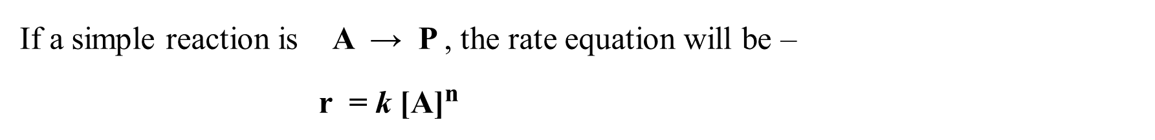
3) Detailed technique of each method
(a) Differential method
If a simple reaction is A → P , the rate equation will be –
r = k [A]^{n}
Or, ln r = n ln [A] + ln k
Thus a plot of ln r vs. ln [A] h will be a straight line with slope equal to n and intercept equal to ln k
ln r
slope = n
= order w.r.t. A
ln k
ln [A]
4

Slide 6
3) Detailed technique of each method
(a) Differential method
Now the rate can be determined by two ways:
(i) By measuring concentration with time using a single concentration and determining rate at different time. This order is n_{t} , order w.r.t. time.
●
Slope = rate of the reaction (r)
[A]
ln r
●
Slope = n_{t}
= Reaction order w.r.t time
●
time
ln [A]
Fig: P
Fig: Q
Fig: (P) A single concentration vs time curve, with slopes measured at various réactant concentrations. Fig: (Q) A plot of ln r vs ln [A]
5

Slide 7
3) Detailed technique of each method
(a) Differential method
(ii) By measuring concentrations with time using several different initial concentrations and then determining initial rate at zero time. This order is n_{c} , order w.r.t. concentration, or true order .
●
Slope = Initial reaction rate (r_{i})
●
●
ln r_{i}
[A]
Slope = n_{c}
= Reaction order w.r.t Conc.
●
●
time
ln [A]
Fig: M
Fig: N
Fig-(M): Plot of reactant concentrations vs time for various initial concentrations. Fig-(N): A plot of ln r_{i} vs ln [A]
6

Slide 8
3) Detailed technique of each method
(b) Method of integration
The integration methods are use to the integrated rate equation to determine the order of a reaction. The method of integration involves first making a tentative decision as to what the order of the reaction might be.
For this method we have to calculate the values of rate constant, k from the integrated rate equation and from the knowledge of initial concentration, [A]_{o} and the concentration at various time intervals [A]
If all the values of k are same or nearly equal for different values of concentration to the corresponding rate equation then order can be determined.
8

Slide 9
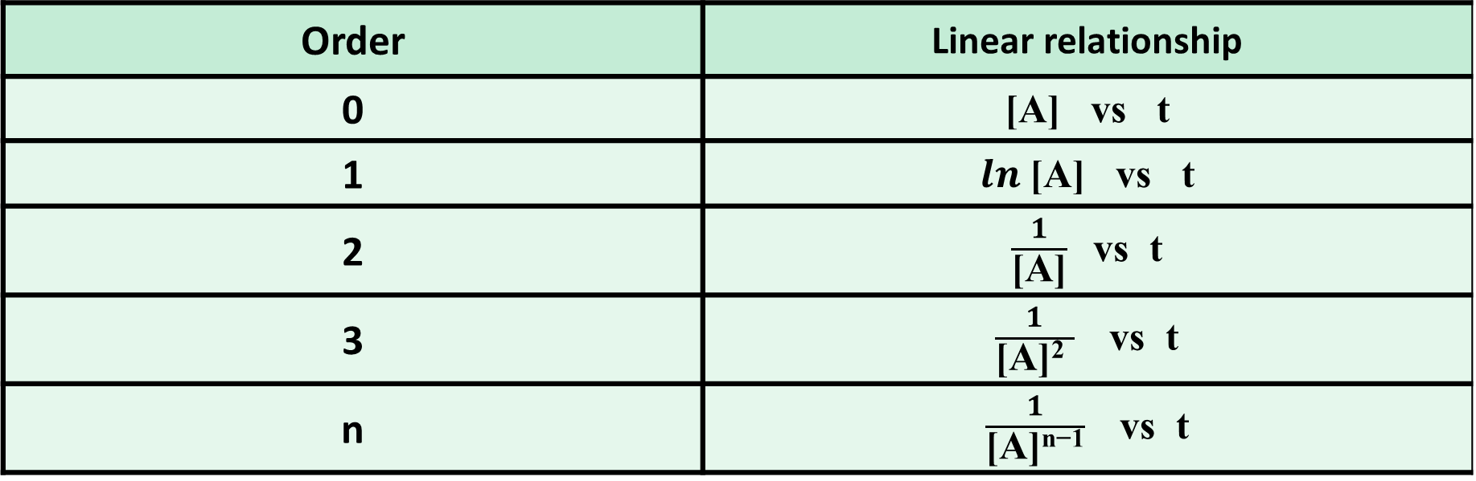
3) Detailed technique of each method
(b) Method of integration
This method is based on the method of integration. The linear relationship of reaction with different order is different.
Order | Linear relationship
0 | [A] vs t
1 | $ln$[A] vs t
2 | $\frac{1}{\text{[}\text{A}\text{]}}$vs t
3 | $\frac{1}{\text{[}\text{A}\text{]2 }}$vs t
n | $\frac{1}{\text{[}\text{A}\text{]}\text{n}\text{−1}}$vs t
10

Slide 10
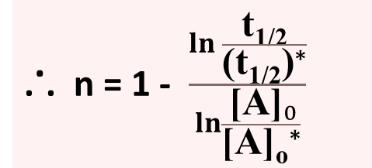
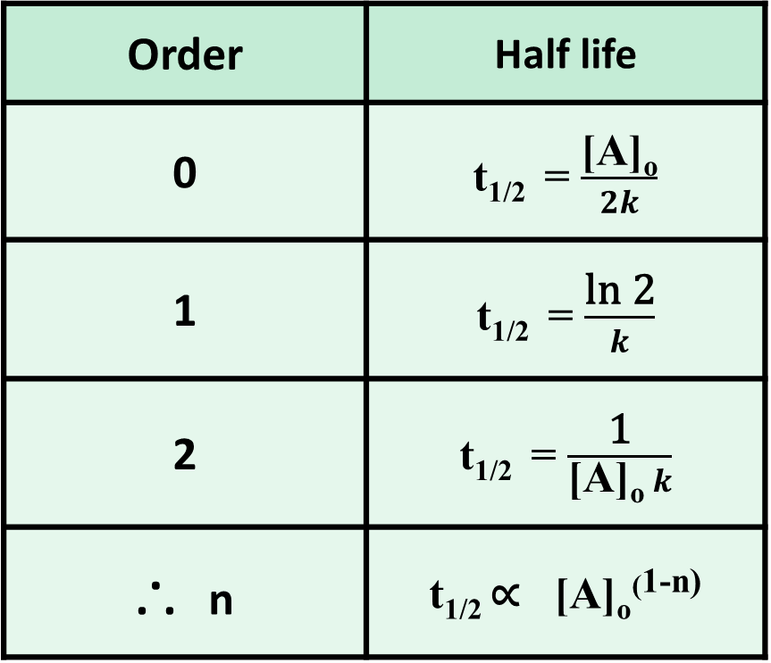
3) Detailed technique of each method
(d) Half-life method
This is also based on the integrated rate equation. The half life of a reaction is proportional to the initial concentration of the reactant.
Order | Half life
0 | t_{1/2} = $\frac{\text{[}\text{A}\text{]}\text{o}}{2k}$
1 | t_{1/2} = $\frac{\text{ln}\text{ 2}}{k}$
2 | t_{1/2} = $\frac{\text{1}}{\text{[}\text{A}\text{]}\text{o} k}$
... n | t_{1/2} ∝ [A]_{o}^{(1-n)}
... n = 1 - $\frac{\ln{\frac{\text{t}\text{1/2}}{\text{(}\text{t}\text{1/2}\text{)}\text{∗}}}}{\ln{\frac{ {\text{[}\text{A}\text{]}}_{0}}{\text{[}\text{A}\text{]}\text{o}\text{∗}}}}$
11

Slide 11
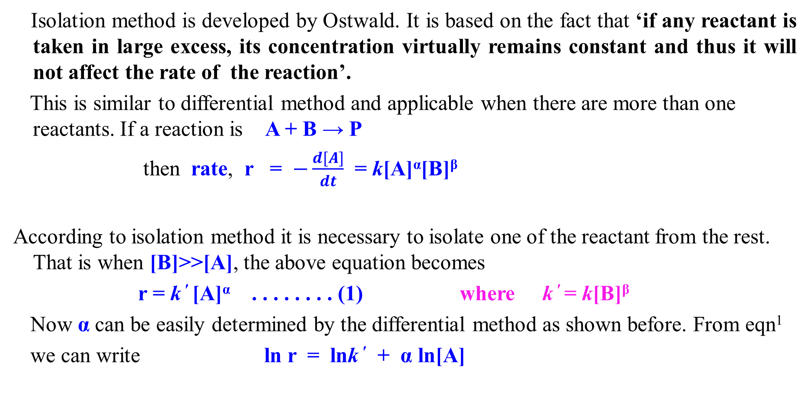
3) Detailed technique of each method
(e) Isolation method
Isolation method is developed by Ostwald. It is based on the fact that ‘if any reactant is taken in large excess, its concentration virtually remains constant and thus it will not affect the rate of the reaction’.
This is similar to differential method and applicable when there are more than one reactants. If a reaction is A + B → P
then rate, r = $−\frac{d[A]}{dt}$ = k[A]^{α}[B]^{β}
According to isolation method it is necessary to isolate one of the reactant from the rest. That is when [B]>>[A], the above equation becomes
r = k ′ [A]^{α} . . . . . . . . (1) where k ′ = k[B]^{β}
Now α can be easily determined by the differential method as shown before. From eqn¹
we can write ln r = lnk ′ + α ln[A]
12

Slide 12
3) Detailed technique of each method
(e) Isolation method
Thus a plot of ln r vs ln[A] will be straight line with a slope equal to order, α. Fig(E1)
Similarly the value of β can be determined when [A]>>[B]
So overall order of the reaction will be n = α + β
ln r
slope = α = order w.r.t. A
lnk ′
ln [A]
Fig(E1)
But the condition [A]>>[B] can not be applied all-time when A is solute and B is solvent. Then the following techniques should be applied.
13

Slide 13
3) Detailed technique of each method
(e) Isolation method
The reaction is carried out under the conditions of [B]>>[A] with at least three different concentrations of [B] i.e [B]₁ , [B]₂ , [B]₃ ; the similar curve like Fig(E1) will be found with the same slope (α) and different intercepts (ln k ′) : Fig(E2)
A plot of these intercepts (ln k ′) against the concentration of ln[B] will result a straight line with slope equal to β and the intercept will be lnk : Fig(E3)
k ′ = k[B]^{β} or, lnk′ = lnk + β ln[B]
[B]₃
[B]₁
[B]₂
slope = α
ln r
ln k ′
slope = β = order w.r.t. B
ln k₁ ′
Intercepts ln k₂ ′
ln k₃ ′
ln k
ln [A]
ln [B]
14
Fig(E2)
Fig(E3)

Slide 14
4) Comparison of methods
Differential method | Integration method
No previous knowledge is required i.e. it does not require a tentative decision as to what the order should be. | This method is known guess and try or trial and error method. As it requires a tentative decision as to what the order should be.
Fractional order can be determined. | Fractional order can not be determined.
Clear distinction between 1.8 and 2 or 0.8 and 1 orders is possible. | Clear distinction between 1.8 and 2 or 0.8 and 1 orders is not possible.
It gives important information about the reaction. | No information about the reaction can be obtained.
n_{c} | = n_{t} | Both intermediate and product do not affect the reaction
 | < n_{t} | Intermediate or product inhibit the reaction
 | > n_{t} | Intermediate or product catalyze the reaction
15

Slide 15
4) Comparison of methods
Half-life method | Isolation method
It is valid only if when n_{c} = n_{t} and like integration method it has limited applicability. The method is not recommended for reactions or previously unknown kinetics | As it is based on differential method it has similar advantages of differential method. when there are more than one reactants, this is very useful.
16

Slide 16
Bibliography
Chemical Kinetics by Keith J. Laidler
Chemical Kinetics and Photochemistry by Prof. Dr. Md. Mufazzal Hossain and Abdur Rahim
Thank You

